Slide 1

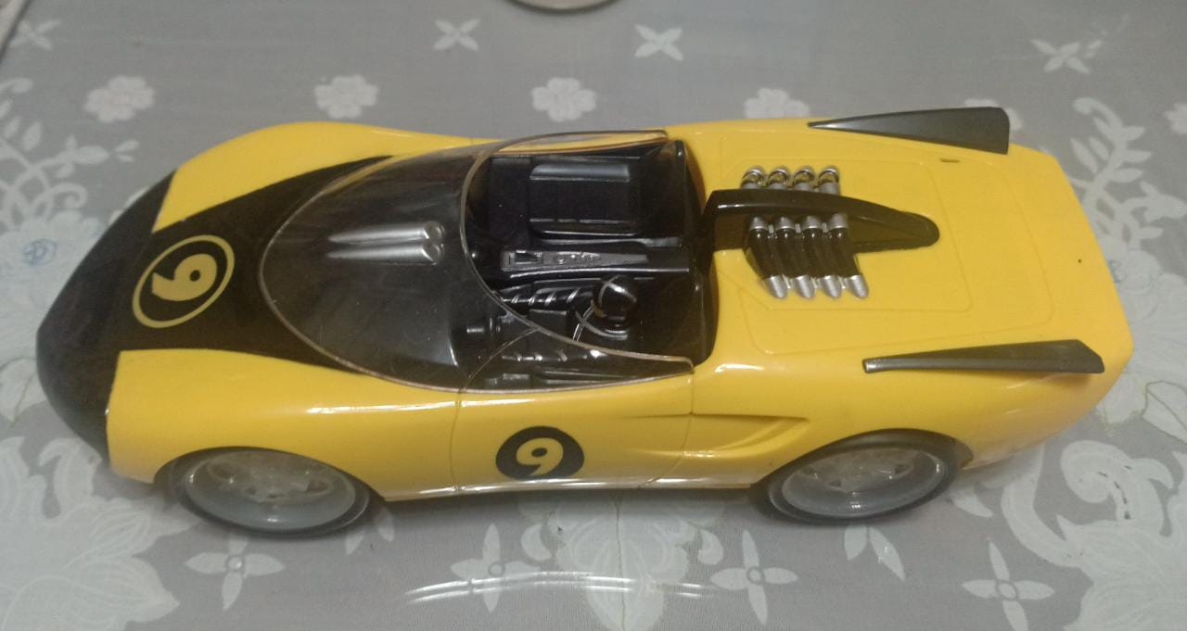
RC car
Atmega32 Serial communication via Bluetooth
AI developer mohamed Emad

Slide 2
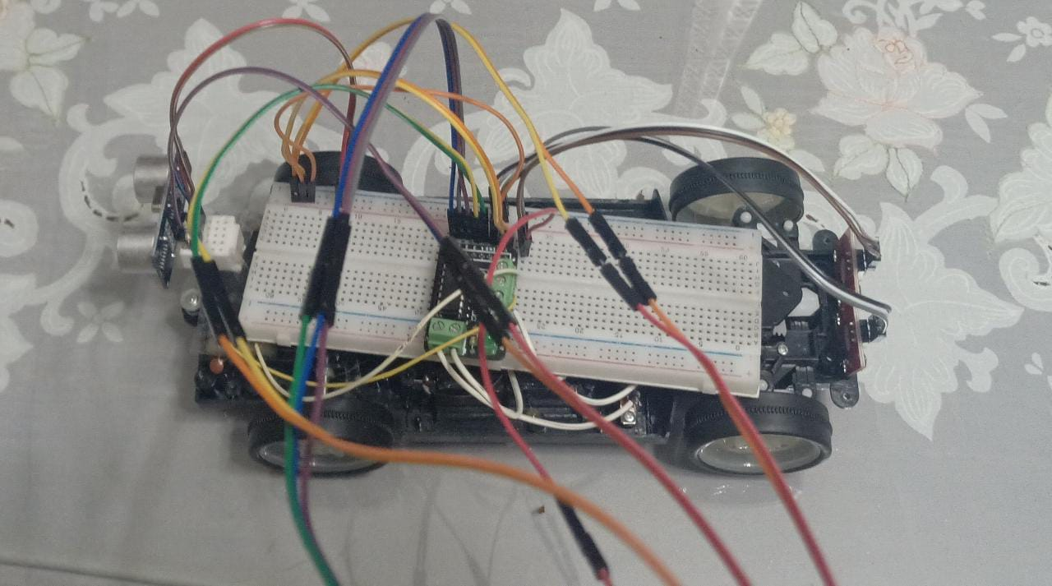
Introduction
Bluetooth controlled car is a robot which is built using Atmega32 Microcontroller in which serial communication is done via Bluetooth and Programming is done in embedded C language .

Slide 3
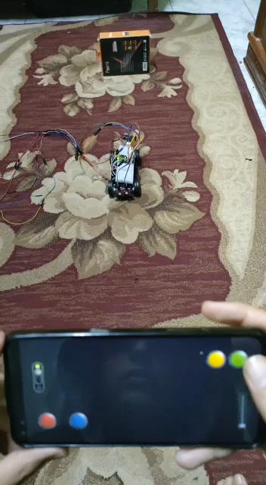

Slide 4
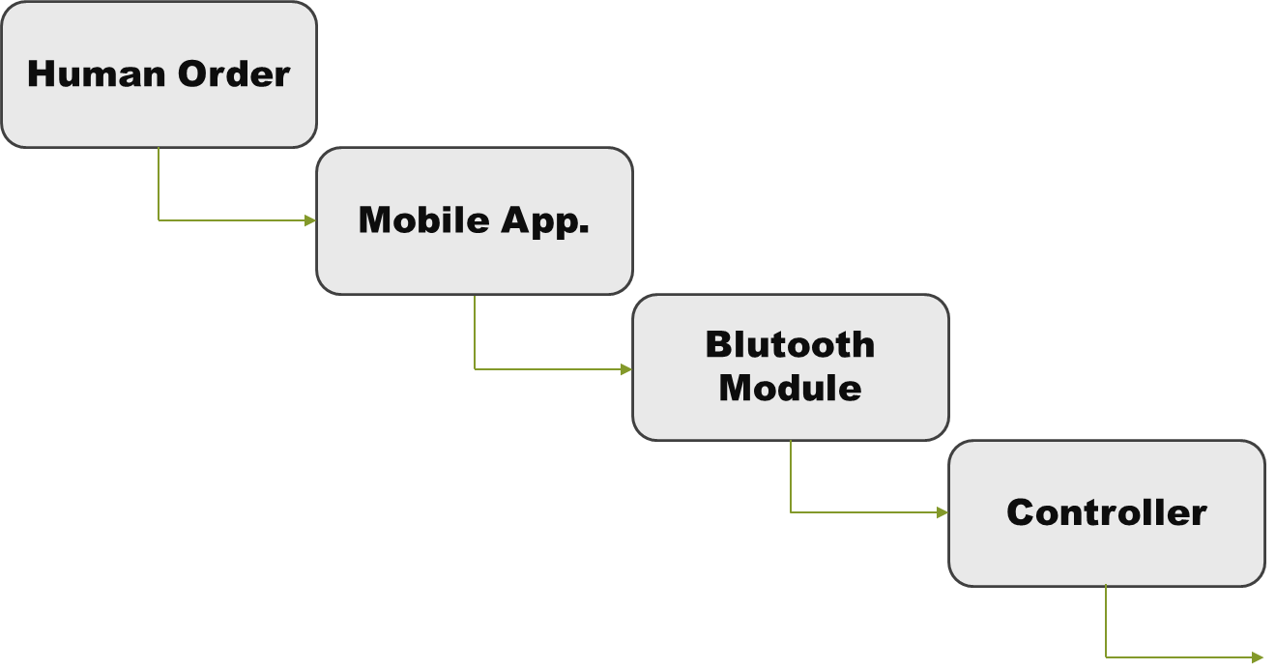

System control :

Slide 5
Atmega32 Microcontroller
High performance and low power microcontroller
RISC Architecture
Up to 16MIPS throughput 16MHz
2 KB RAM and 1024 Bytes EEPROM
Programmable Serial USART
Programmer friendly

Slide 6
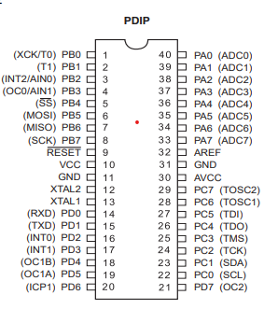
PIN CONFIGURATION

Slide 7
What is Bluetooth ?
RF based wireless technology
Low cost
Short range
Less power Consuming
Speed Less than 1Mbps
HC-05
Work modes :
Order-response work mode
Automatic connection work mode

Slide 8
USART PROTOCOL
Full duplex Asynchronous or synchronous operation
Master or slave synchronous operation
Framing Error Detection
Multi processor communication mode
Double speed Asynchronous communication mode

Slide 9
RC Car Components in the project
2 Atmega32
3 Bread board
2 Motors
1 Battery slot
HC-05 Bluetooth module
1 HC-SR04 Ultrasonic Module
1 H-bridge

Slide 10

Led
Buzzer
Dc motor
Microcontroller
1
Microcontroller
2
Bluetooth module
HC -05
Ultrasonic Module
HC-SR04
Dc Steering motor

Slide 11
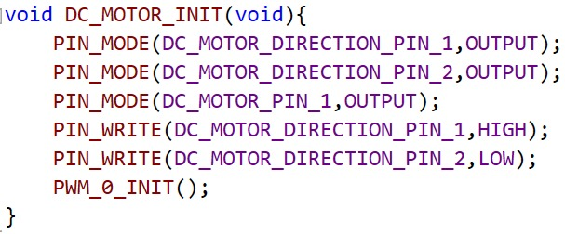
First microcontroller (main)
DC Motor code :
1.INIT
To initialization the motor

Slide 12
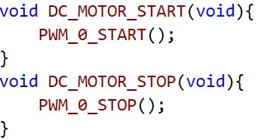
2.DC Motor start control
To start and stop the motor

Slide 13
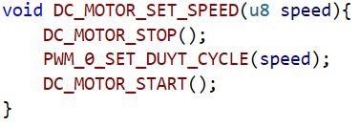
3 .DC Motor speed control
To control the speed
*Using timer 0 to control the speed

Slide 14
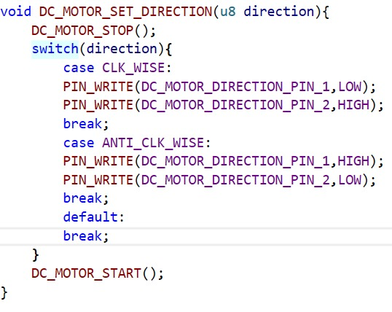
4. DC Motor Direction
To control the direction of the motor
controlled by input 1 &2 in H-bridge
If input (1,0) the direction will be anticlockwise
If input (0,1) the direction will be clockwise

Slide 15
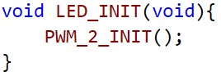
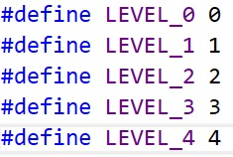
LED code :
1.INIT
To initialization the LED
By using timer 2

Slide 16
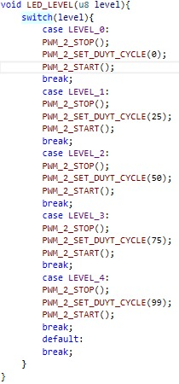
2.LED LEVEL
To control led Level
Level_0 ➔ Led is off
Level_1 ➔ Led intensity is ¼
Level_2 ➔ Led intensity is ½
Level_3 ➔ Led intensity is ¾
Level_4 ➔ Led is in full intensity

Slide 17
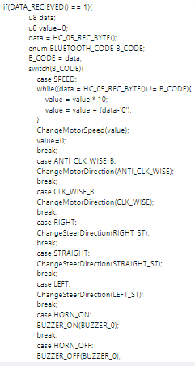
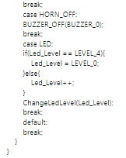
Bluetooth module code :

Slide 18
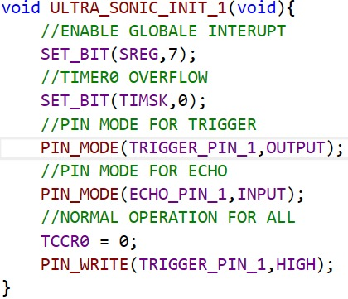
Second microcontroller
Ultrasonic code :

Slide 19
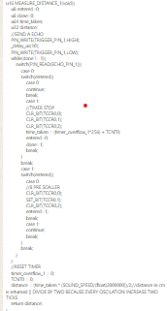
Ultrasonic code :
Using timer 0
From the equation time taken=(timer_overflow_1*256)+ TCNT0
Distance=(time taken *(Sound speed /(float)2000000))/2 in cm

Slide 20
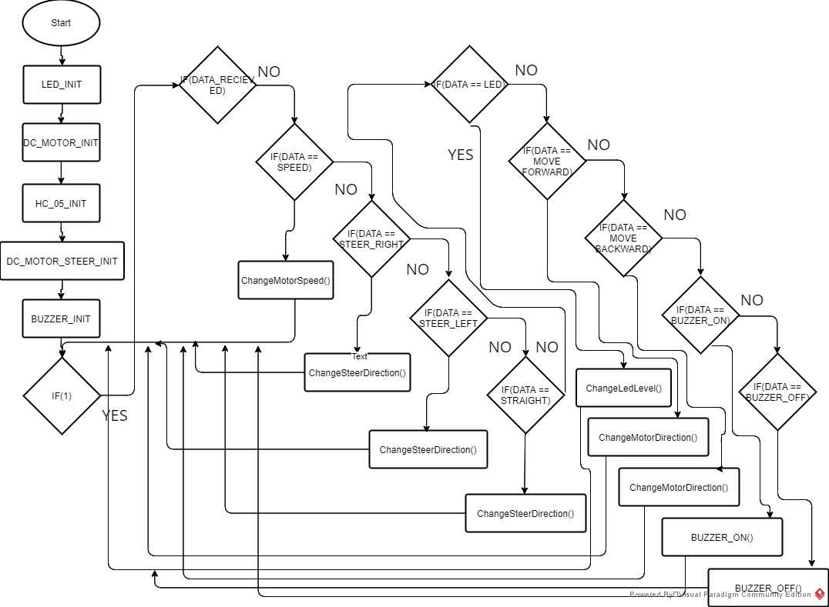
Project Flow chart

Slide 21
Thank you for your kind attention

